Slide 1

Capstone: churn rates
learn SQL From Scratch

Slide 2
Table of contents…
SECTION 1: Getting Familiar With Codeflix
SECTION 2: What is the overall churn trend since the company started?
SECTION 3: Comparing the churn rates between the segments

Slide 3
Getting familiar with codeflix…

Slide 4
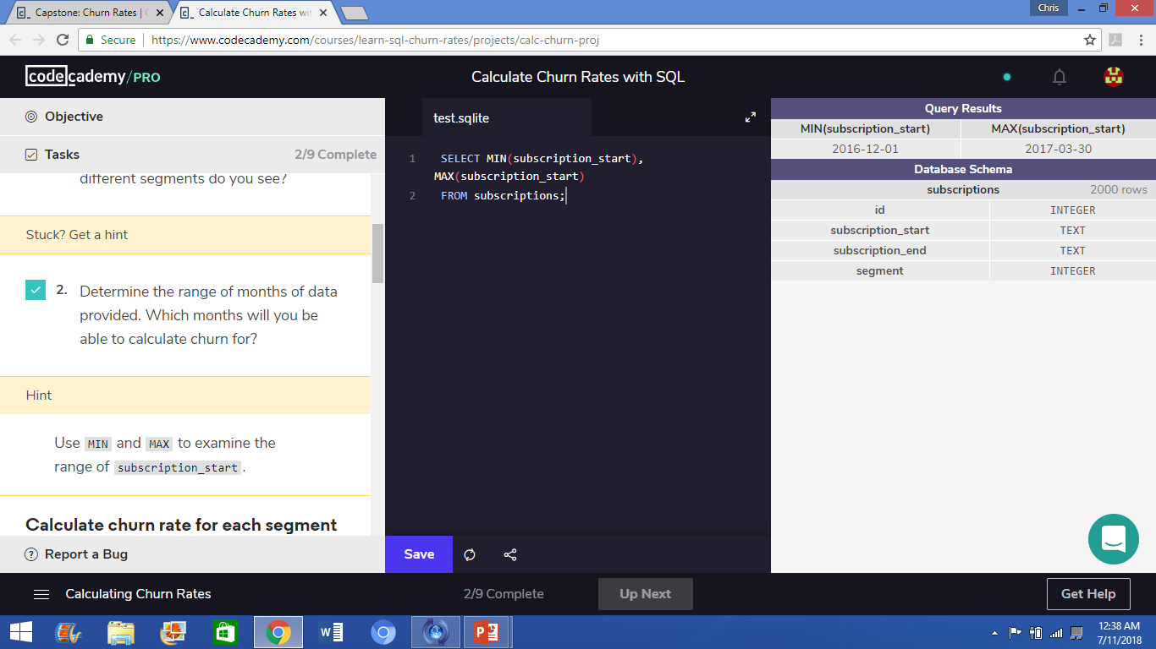
About codeflix:
Codeflix has been a company for four months now. And as everyone is excited to see how the progress is doing, the management team wants to calculate the churn rate for subscriptions.
As the company is so new, there are only three months with sufficient data to calculate the churn rate: January of 2017, February of 2017, and March of 2017.

Slide 5
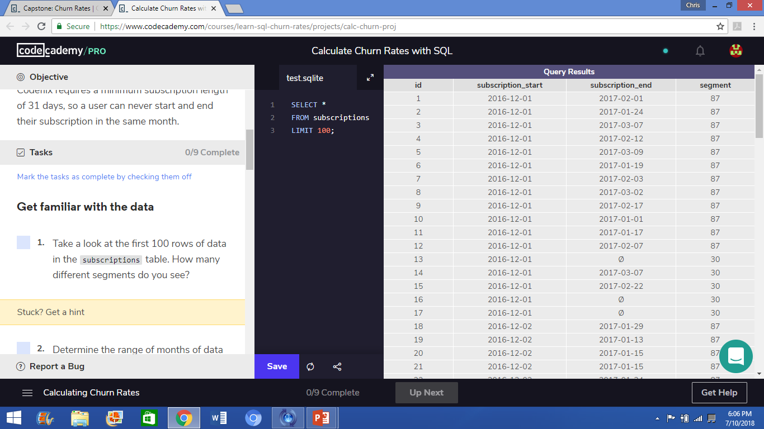
ABOUT CODEFLIX:
Since the business is in it’s earliest stages, people are excited to know how everything is going in the business. Management is interested in knowing about the subscription churn rates.
There are 2 segments of users that the marketing department was interested in, which are circled in the image to the right.

Slide 6
What is the overall churn trend since the company started?

Slide 7
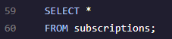
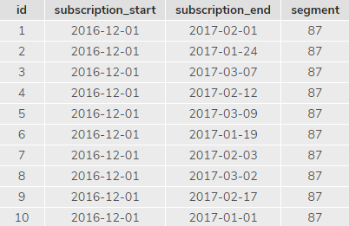
Understanding the data given…
At Codeflix, data is recorded about each customer, in a table called “subscriptions”.
This table records:
The customer’s ID
The date the customer subscribed
The date the customer cancelled their subscription
The segment to which the customer is subscribed

Slide 8
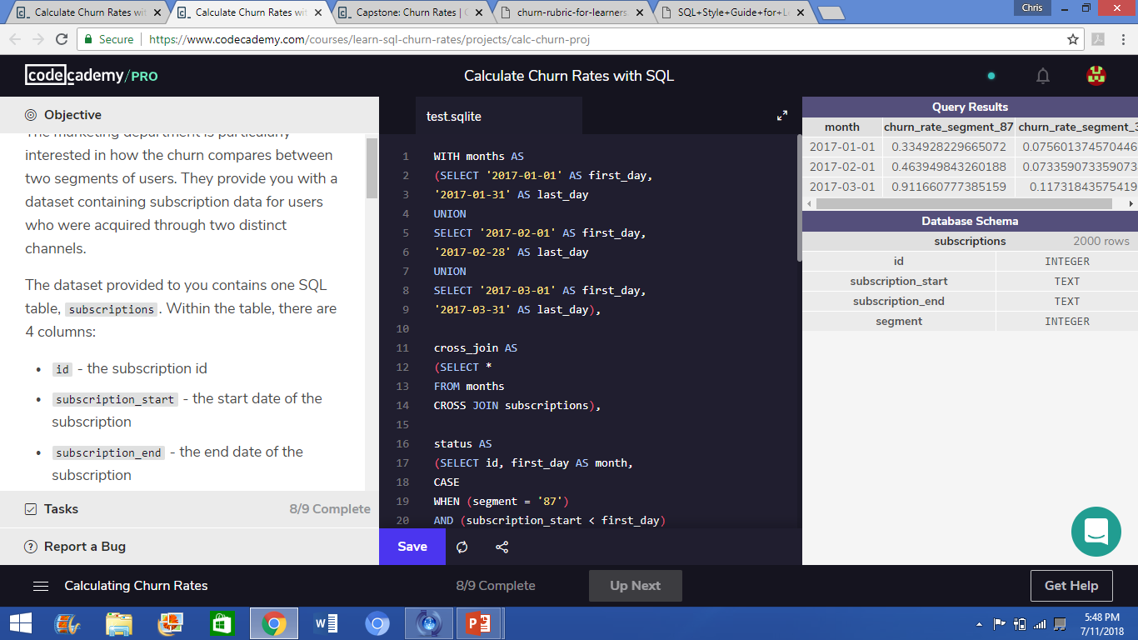
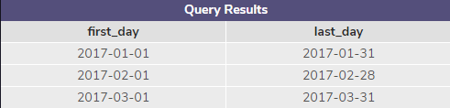
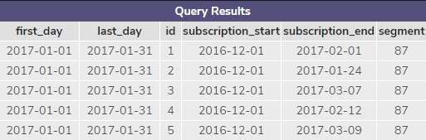
Calculating the churn rates:
To organize the churn rate into separate months, a months table is made first.
Using UNION, we combine the three months: January, February, and March, of 2017, and rename the dates as “first_day”, for the first day of each month, and “last_day”, for the last day of each month.
Then, we cross-join the months table with the subscriptions table, by creating a cross-join table.

Slide 9
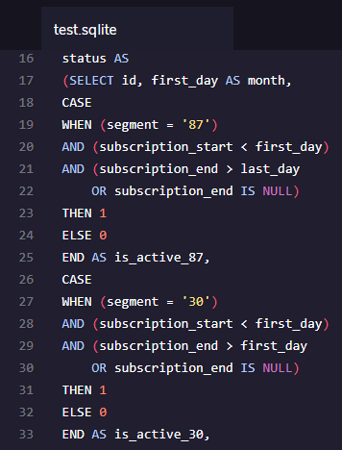
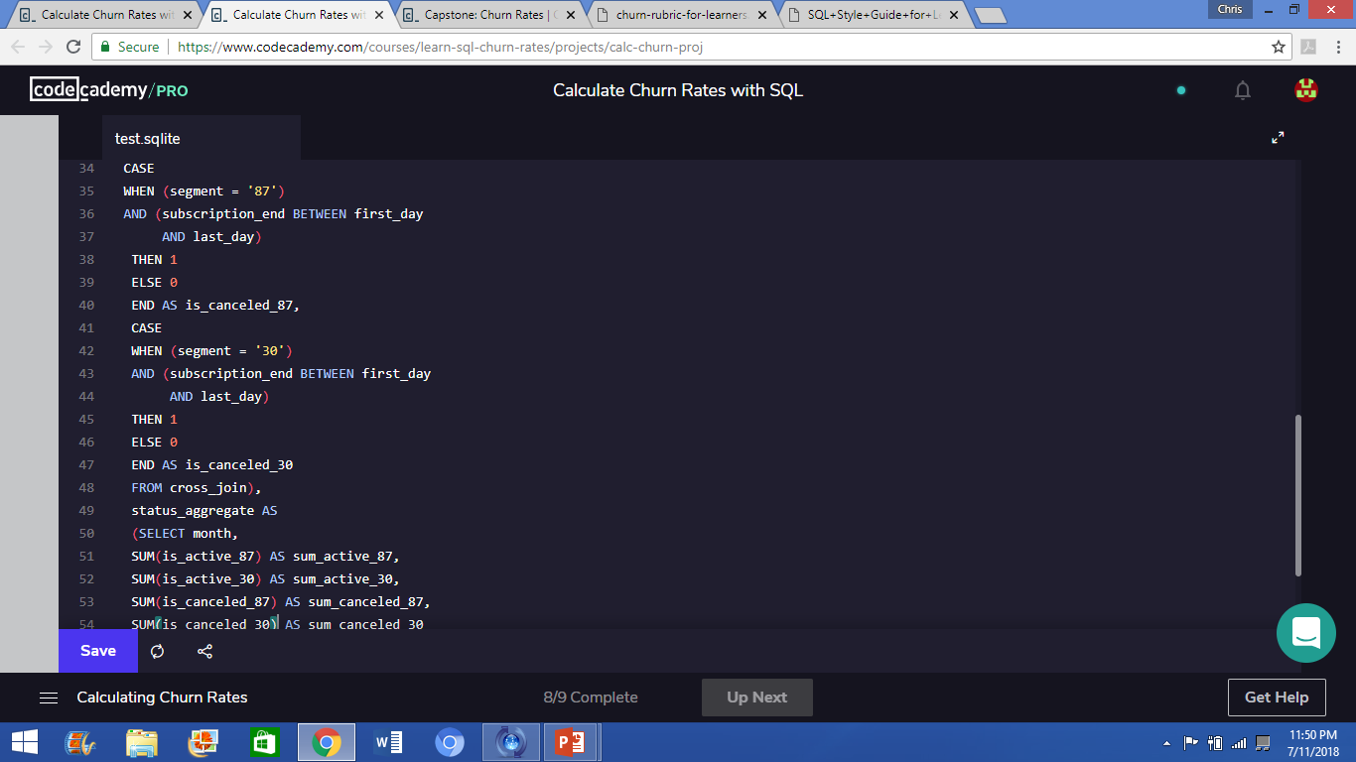
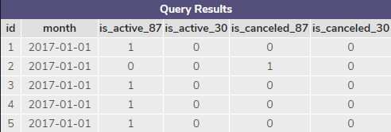
Calculating the churn rates:
Active subscriptions code:
Cancelled subscriptions code:
After joining the two tables, a temporary table is created, called “status”, to confirm active subscriptions and cancelled subscriptions.
For this table, the activity of each account is recorded. The start date and cancel date for each member is used from the cross_join table, and all the active and cancelled subscriptions are revealed, for each segment: segment 87 and segment 30.

Slide 10
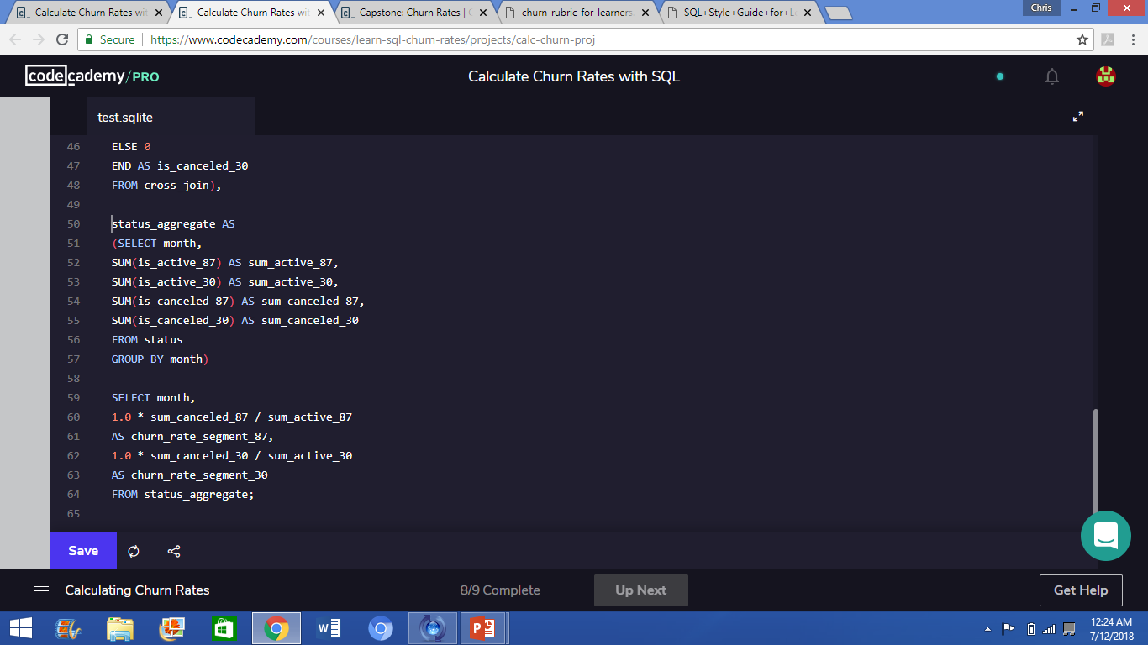
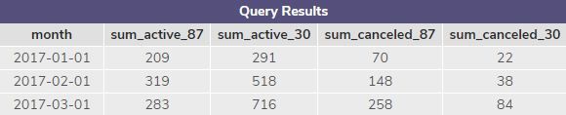
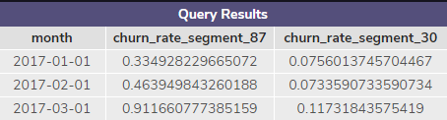
Calculating the Churn rate:
After creating the status table, the total sum of each category (active for segment 87, active for segment 30, cancelled for segment 87, and cancelled for segment 30) is calculated creating a status aggregate table.
Now, the churn rates for each segment can be calculated.
The calculation of the churn rate is simple:
sum of cancelled subscriptions /
sum of active subscriptions
However, for SQL, to receive decimals, rather than just rounded integers, we must multiply either the numerator or the denominator by 1.0
Now we have our churn rates!!!!!

Slide 11
Comparing the churn rates between segment 87 and segment 30…

Slide 12
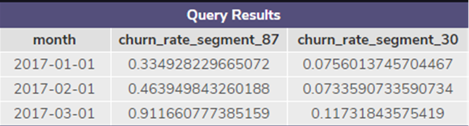
Analyzing the data…
Now that the churn rates have been calculated for segment 87 and segment 30, we can compare them side by side.
From the churn rate, the customer satisfaction can be understood, based on the amount of cancellations occurring within a segment.
Therefore it is concluded that the higher the churn rate, the higher amount of subscription cancels within that month; the higher number of subscription cancellations, the lower customer satisfaction is.
It can be seen, through the churn rate, that segment 30 has higher customer satisfaction than segment 87.

Slide 13
About company expansion:
Since customer satisfaction is higher for segment 30 of Codeflix, the smart business move would be to expand the company with regards to segment 30 production.
Expanding segment 30 will give a higher potential profit for Codeflix than expanding segment 87, and higher customer satisfaction.
Expanding segment 30 over segment 87 is a lower risk investment for the company, which is always a good thing.

Slide 14
Thank you!
-Christopher hall

